Slide 1
CIS Foundations of Machine Learning
Chapter 14
Working with KerasTensorFlow

Slide 2

Good Reference for learning Deep Learning
He is the author of Keras which has been incorporated into TensorFlow
This is one of easiest book to start with Deep Learning with practical coding examples
Deep Learning with Python: Chollet, Francois: 9781617294433: Amazon.com: Books

Slide 3
Outline
Introduction
Building Blocks of Keras and TensorFlow

Slide 4
What is Keras and TensorFlow?
TensorFLow is a Python-based, free, open-source machine learning platform, developed primarily by Google. Much like NumPy, the primary purpose of TensorFlow is to enable engineers and researchers to manipulate mathematical expressions over numerical tensors. But it goes far beyond,
It can automatically compute the gradient of any differentiable expression
It can run not only on CPUs, but also on GPUs and TPUs,
Computation can be distributed across many machines
TensorFlow programs can be exported to other runtimes, such as C++, JavaScript or even TensorFlow Lite for running on mobile devices
Think of it as a platform. There’s TF-Agents for reinforcement-learning
Summary: it is not just for deep-learning

Slide 5
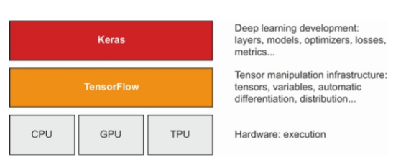
What is Keras and TensorFlow
Keras is a deep learning API for Python, built on top of TensorFlow, although it has gone through a few phrase of development that was very different before.
Through TensorFlow, Keras can run on top of different types of hardware
TensorFLow is a low-level tensor computing platform, and Keras is a high-level deep learning API

Slide 6
History
History between Keras and TensorFlow
March 2015 Keras first release which is built on top of Theano
November 2015 first release of TensorFlow 1.0
September 2016 Keras becomes TensorFlow backend
2016 to 2017 Keras becomes default front-end of TensorFlow
2017 Add CNTK and MXNet as additional backend
2018 Keras becomes official API for TensorFlow
2018 to 2019 both Theano and CNTK are out of development and Keras is back to
2019 TensorFlow 2.0 released. Keras becomes part of TensorFLow
https://www.youtube.com/watch?v=j_pJmXJwMLA&ab_channel=SirajRaval

Slide 7
History between Keras and TensorFlow
A lot of online tutorial may not work anymore
Latest TensorFlow is 2.0
Keras is part of TensorFlow now
Mine may not work in a year or so too
When in doubt, ask Google

Slide 8
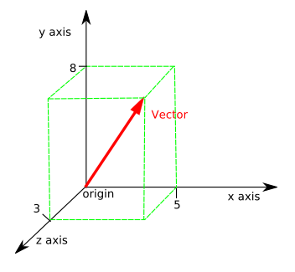
Mathematical Foundation - Linear Algebra
Vector – An array of numbers which can be used to represent the coordinates of a point in a n-dimensional space.
Example v = (5, 8, 3) in 3-dimensional space with x=5, y=8, z=3
A vector has a magnitude as well as a direction.
Example is velocity
One can visualize 2-dim or 3-dim vector graphically, but not anything
larger than 4.
Scalar – A single number which include only magnitude and no direction.
It can be defined as one-dimensional vector.
Examples: weight, height, temperature

Slide 9
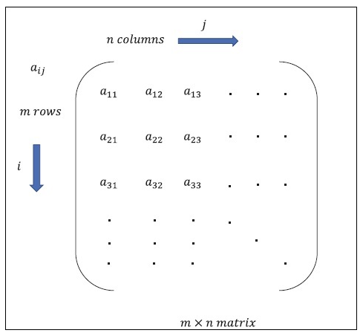
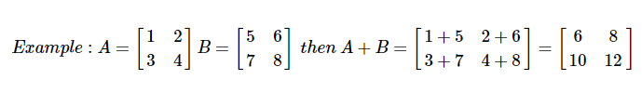
Mathematical Foundation - Linear Algebra
Matrix - Matrix can be defined as multi-dimensional arrays, which are arranged in the format of rows and columns. The size of matrix is defined by row length and column length. Following figure shows the representation of any specified matrix.
Addition

Slide 10
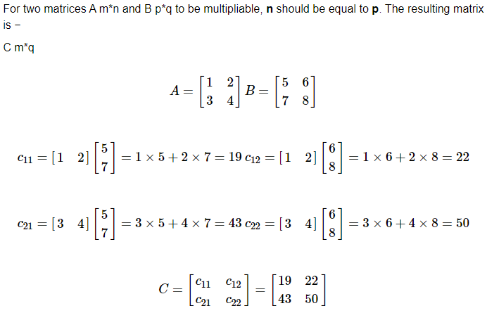
Matrix Multiplication

Slide 11
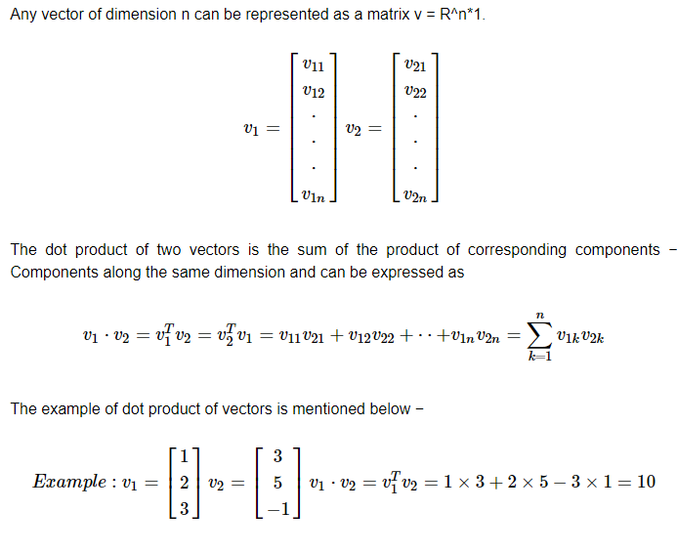
Dot product of vectors

Slide 12
Deep Learning Building Block
Tensor

Slide 13



Deep Learning Building Block
What is the difference between an Ant, Bart Simpson and Dr. Strange?
1-dimension
3-dimensions
n-dimensions
They live in different dimensions

Slide 14
Deep Learning Building Block
Type of Data according to its dimensions (or Rank)
1-dimensional data (Temperature)
2-dimension data (DataFrame)
All Data we have deal with so far are of 2-dimension

Slide 15
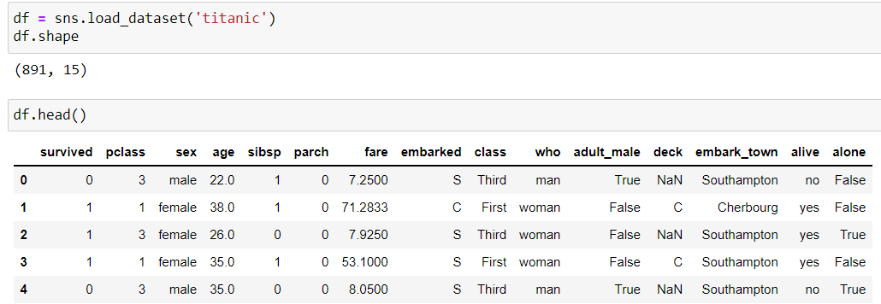
2-dimensional data (samples, features)
Data are represented as rank-2 numpy array
Rows are the different samples, Columns are different features

Slide 16
Tensors (multi-dimensional array)
Vector data – 2D tensors (samples, features)
Timeseries data or sequence data – 3D tensors of shape (samples, timesteps, features) (tensor of rank-3)
Images – 4D tensors of shape (samples, height, width, channels)
Video – 5D tensors of shape (samples, frames, height, width, channels)

Slide 17
Warnings: Confusion of terminology
The rank of a tensor refers to the number of dimensions present within the tensor.
Example: A rank-2 tensor is a 2d array with rows and columns. In Linear Algebra, it is just a matrix so a matrix, a 2d-array and 2d-tensor refer to the same thing.
A tensor’s rank tells us how many indexes are needed to refer to a specific element within the tensor
Time-series data can be represented as a tensor of rank 3 which is also referred to as a 3D-tensor
However, we also often refer the number of elements of a Vector which is a tensor of rank 1 as the dimensions as well
Example: In traditional 3-d simulation, any data point is represented by a vector v = (x, y, z) coordinate such as v = array([1, 2, 3]), v is called a 3-dimensional vector.
v = array([1,2,3,4,5]) is a 5-dimensional vector
https://deeplizard.com/learn/video/AiyK0idr4uM#:~:text=An%20axis%20of%20a%20tensor,the%20length%20of%20each%20axis.

Slide 18
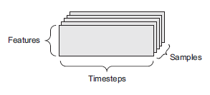
TimeSeries of sequence data (3D) (samples, timesteps, features)
Example:
Stock Price over time
(height, weight, age) over time
Crime rate of a city over time

Slide 19
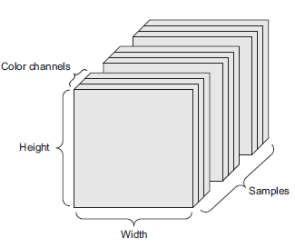
Image data (4D) (samples, height, width, channels)
A batch of 128 grayscale images of
size 256 × 256 could thus be stored in a tensor of shape (128, 256, 256, 1), and a batch of 128 color images could be stored in a tensor of shape (128, 256, 256, 3)
3 is for Red, Green, Blue code
256 represents the size of the image

Slide 20
Video data (5D) (samples, frames, height, width, color-depth)
Each sample of a video is a series of images
Captured of number of frames per second
For instance, a 60-second, 144 × 256 YouTube video clip sampled at 4 frames per
second would have 240 frames. A batch of four such video clips would be stored in a
tensor of shape (4, 240, 144, 256, 3). That’s a total of 106,168,320 values! If the
dtype of the tensor was float32, then each value would be stored in 32 bits, so the
tensor would represent 405 MB. Heavy! Videos you encounter in real life are much
lighter, because they aren’t stored in float32, and they’re typically compressed by a
large factor (such as in the MPEG format).

Slide 21
Online Resources
https://blog.keras.io/keras-as-a-simplified-interface-to-tensorflow-tutorial.html
https://colab.research.google.com/github/fchollet/deep-learning-with-python-notebooks/blob/master/chapter04_getting-started-with-neural-networks.ipynb

Slide 22
Introduction to Keras and TensorFlow
Learning by doing

